Slide 1
Domain Driven Design
Daniel Połaczański
Szymon Kowal
Tomasz Dubikowski
07.02.2014
Notes:
<numer>

Slide 2
Agenda
•Problems of present-day systems
•What isDDD?
•Ubiquitous language
•Strategic Design
•Building Blocks

Slide 3
Problems of present-day systems?
Featuresofbusinesssoftware:
Relativelynot complicated:
Complicatedalgorithms are rarity
Simple operations:
shuffling of the data from one heap to another one
continuously changes
Supports running a business

Slide 4
Symptoms of inadequate solution
Big Ball of Mud
Adding new features without attention tomodel
owingtechnical debt
Unclean code
Withoutbusiness rulesandprocesses
Not understandable code
New Requirments vs API
Hard to implement new requirments with current api
Difficult changes
New changes = new problems
After a change nothing works
Entropy always increases...

Slide 5
What to do?
Insanity is doing the same thing, over and over again, but expecting different results.

Slide 6

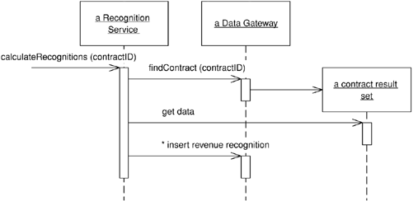
Transaction script – domain logic pattern
Organizes business logic by procedures
Each procedure handles single business case
Adequate to small applications with simple business logic (ex: CRUD)

Slide 7
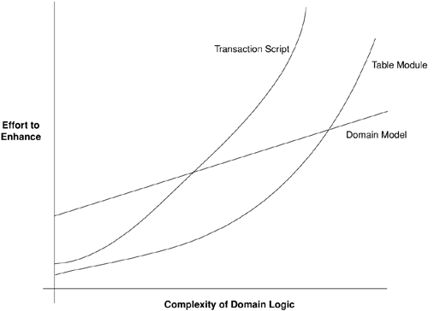
Complexity
- EssentialComplexity (unavoidable) - comes from nature of problem
- AccidentalComplexity – caused by a suboptimal approach to the problem's resolution
Complexity

Slide 8
What is DDD
from http://domaindrivendesign.org/resources/what_is_ddd:
"Domain-driven design is not a technology or a methodology. It is a way of thinking and a set of priorities, aimed at accelerating software projects that have to deal with complicated domains.".

Slide 9
Model – core of DDD
What model is based on?
- Model is hearth and main business value of system.
- Model represents business domain. Gathers knowledge about rules and dynamics of domain.
- Modelling is the the most difficult task.
- Model representsmutually agreed comprehensionby developers, analytics, client
- Model isdescriptionandsimplificationofbusiness realitywithout useless details
What is not DDD?
Database – doesnt model behaviour, static, doesn't express intentions

Slide 10
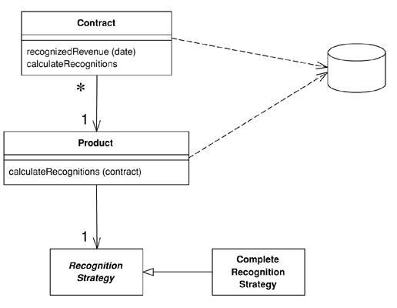
Model - how to express
Draws
Anything understandable by business experts and developers
UML
Draws specific for businessdomain
Text
People think by “stories”
Analytic documentation is design of business logic as well

Slide 11
What is DDD
Development driven by understanding of domain
Technology agnostic
Pragmatic approach to OOD and OOA:
Focused on business domain
Reducing complexity
Changes easy to implement
Analyse and design is one phase
There is technically nothing new or revolutionary in DDD, there is only a guide to better way of thinking

Slide 12
Three fundaments of DDD
Ubiquitous language
Strategic design
Building blocks

Slide 13
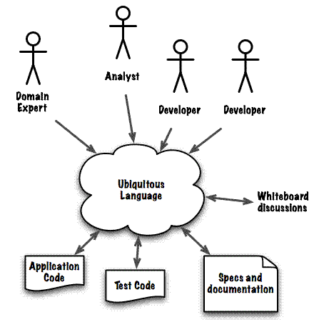
„Ubiquitous Language“
Common mental mode l= effective communications
Worked out and used by everyone in team(domain expert, analyst, developer, tester)
Change in the ubiquitous language = change in code and model

Slide 14
Strategic design
Core Domain
Main reason why we create system, main business value.
This is what distinguish company from competitors.
We make here DDD:
Detailed analyse, business archetypes, design patterns, testability…
Engaging best people
Should be small
Supporting Domain
Additional features, not critic functionality
Low quality is acceptable
Outsourcing
Generic Domain
Specific, common domain (ex: accounting)
You can buy it
Avoid dependencies from core domain

Slide 15
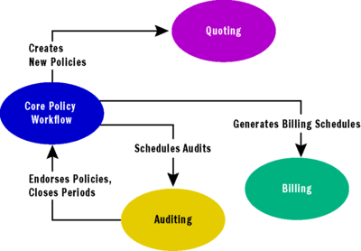
Strategic domain – bounded countext
Bounded Context – dividing domain on smaller chunks
„Policy” can have different meaning in every context
Defines boundaries of model
Every context has own ubiquitous language
Contexts communicate eachother by interfaces
Dependencies from one context doesnt leak to another

Slide 16
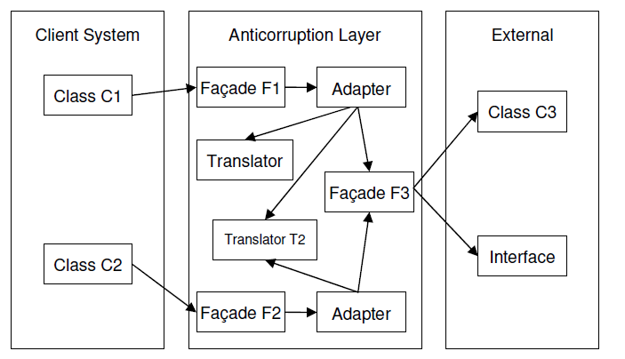
Strategic Design – Anti-corruption layer
Anti-corruptionLayer–communication with external systems

